Slide 1

6x6 Sphere Grid Application in OpenGL (Python)
Work By: Sri Siddarth C

Slide 2
Deliverables 02-01-2024
Deliverables Submitted:
A working windowed application using Python opens in a window on start up using preferred Graphics API OpenGL. ✅
The application is completely self sufficient and should be very simple to run. (The codebase includes a ‘environment.yaml’ (conda env file) and a ‘requirements.txt’ file to easily create an environment for running the code. ✅
The application is light-weight and was able to run on lower-end machines (tested on Windows and Linux) (Lowest CPU and GPU tested: Intel i7-6th Gen & NVIDIA RTX 1050Ti Laptop). ✅
The GitHub Repo also contains a video recording of the application in action. (The screen recording contains the requested sequence of action- Select the 2nd sphere on the top row (somewhere in the bottom right of the sphere) → deselect → 4th on the bottom row (somewhere in the bottom left of the sphere) → center sphere (in the absolute center of the sphere))) ✅
The repo also includes the doc (pdf) & a readme file with a brief description of the implementation details and some of the choices and decisions I have made. ✅

Slide 3
Review 02-01-2024
Application Overview – Stage I
Initial Environment Setting:
I begin setting up a single sphere object in OpenGL to get a more detailed understanding of the libraries and built-in functions.
This included setting up a single sphere with randomized color change upon mouse click.
It also enabled resetting the color changed when clicking at a point outside the sphere. Esc key triggered closing the application.
This code gave a good understanding of defining a new environment and creating a rendering window.
In this stage I also setup up lighting source and opted for the GL_SMOOTH shading model which gave the sphere a more pleasing appearance like the image from the task.

Slide 4
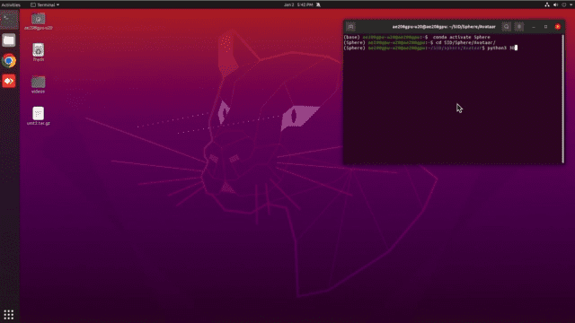
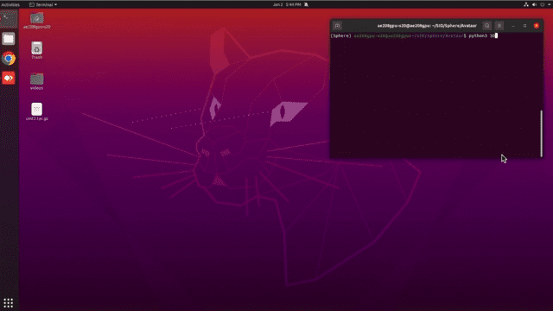
Review 02-01-2024
Rendering
Initial Sphere
Color Change

Slide 5
Review 02-01-2024
Application Overview – Stage II
6x6 Grid Setting:
Finally, I began setting up the grid by positioning spheres with a global positioning frame by setting uniform x axis and y axis offsets.
This helped create a similar rendering from the image given in the task document.
I then extended creating the change in diffuse and spectral linearly across the rows and columns of the grid and captured a similar setup as requested.
I also tried extending this by using an environment map as well which has been shared in the upcoming slide.
During this stage of the project, I learnt a lot about the graphic coding and understanding how the coordinate frame worked which helped me update the spheres accordingly.
I also tested more on the lines of shapes in 3D geometry by rendering hollow shapes and exploring more in these lines.

Slide 6
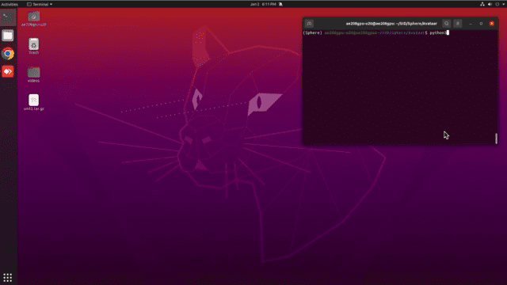
Review 02-01-2024
Rendering
6x6 Grid & Hollow

Slide 7
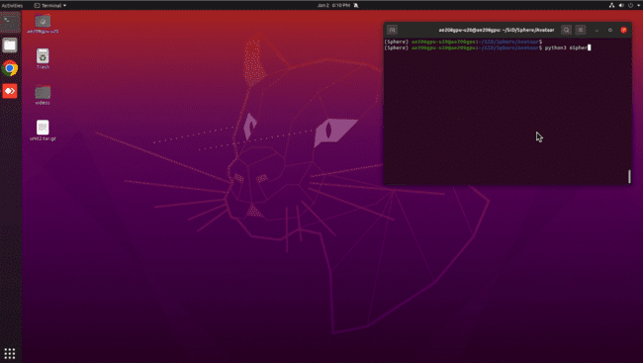
Review 02-01-2024
Rendering
Environment Map

Slide 8
Review 02-01-2024
Application Overview – Stage III
6x6 Grid Setting:
Finally, I began setting up the grid by positioning spheres with a global positioning frame by setting uniform x axis and y axis offsets.
This helped create a similar rendering from the image given in the task document.
I then extended creating the change in diffuse and spectral linearly across the rows and columns of the grid and captured a similar setup as requested.
I also tried extending this by using an environment map as well which has been shared in the upcoming slide.
During this stage of the project, I learnt a lot about the graphic coding and understanding how the coordinate frame worked which helped me update the spheres accordingly.
I also tested more on the lines of shapes in 3D geometry by rendering hollow shapes and exploring more in these lines.

Slide 9

Review 02-01-2024
Discussions on Thought directions
Identifying (row, col) of Sphere upon click:
Rendering window
I decided to convert a mouse point to the identify where the mouse click would be, this would give an estimate on which sphere is being clicked however, this does not tell if the click is inside ( ) or outside( ) the sphere.
For this I adapt the strategy to convert window coordinate to the orthogonal projection coordinate or model coordinate. Using the built-in module gluUnProject that helped convert to model view.

Slide 10
Review 02-01-2024
Sphere Normal
Computing Sphere Normal from Sphere Coordinates:
I used the vectors of the sphere center(s) and the point on a sphere surface. Then finding the difference between these vectors gives a perpendicular vector which passes through the surface.
I then used to divide this vector coordinates with the radius to convert the values between a value of [0,1] which would help with reducing computations.
This vector is then normalized by its magnitude.
def calculate_sphere_normal(x, y, z, l, m, n, radius):
normal_x = (x - l) / radius
normal_y = (y - m) / radius
normal_z = (z - n) / radius
length = (normal_x**2 + normal_y**2 + normal_z**2)**0.5
normal_x /= length
normal_y /= length
normal_z /= length
return normal_x, normal_y, normal_z

Slide 11
Review 02-01-2024
Sphere Normal
Computing Sphere Normal from Sphere Coordinates:
Y-axis
Sphere
Surface point (x, y, z)
The resultant vector is projecting outward towards the user
Sphere Center (x, y, z)
X-axis
Origin

Slide 12
Review 02-01-2024
Sphere Normal
Resetting the Spheres to Normal:
Since the document only mentioned that clicking outside a sphere should changed the previous selection. It does not mention how to reset if multiple spheres are changed, Hence I have used First Changed First Reset order.
This implies that many spheres can be changed, including changes on the same sphere many times, and a buffer memory will append the sphere that was changed and start resetting the spheres based on which was clicked first and start resetting them based on the order of selection.
Clicking on non-Sphere region will start resetting the spheres in this order
Sphere (1, 0) | Sphere (3, 6) | Sphere (2, 1) | … | Sphere (0, 0)
FIFR Buffer Memory

Slide 13
Review 02-01-2024
Coding Details
draw_sphere():
gluNewQuadric(): Allocates and returns a new quadric object. Quadric objects are used to define how geometric primitives (such as spheres) should be rendered.
gluQuadricDrawStyle(quad, GLU_FILL): Sets the drawing style of the quadric object. In this case, it sets the drawing style to filled polygons (sphere will be filled with color).
gluQuadricNormals(quad, GLU_SMOOTH): Specifies the generation of normals for the quadric. (GLU_SMOOTH indicates that normals should be computed per vertex and smoothly interpolated across faces).
gluQuadricTexture(quad, GL_TRUE): Enables texture coordinates for the quadric. (Indicates that texture mapping will be applied to the sphere).
gluSphere(quad, radius, slices, stacks): Renders a sphere using the specified quadric object with the given radius, slices, and stacks.
slices: The number of subdivisions around the Z axis (similar to longitudinal lines on a globe).
stacks: The number of subdivisions along the Z axis (similar to latitudinal lines on a globe).
def draw_sphere(radius, slices, stacks):
quad = gluNewQuadric()
gluQuadricDrawStyle(quad, GLU_FILL)
gluQuadricNormals(quad, GLU_SMOOTH)
gluQuadricTexture(quad, GL_TRUE)
gluSphere(quad, radius, slices, stacks)

Slide 14
Review 02-01-2024
Coding Details
setup_lighting():
glShadeModel(GL_SMOOTH): Using a smooth shading (personal choice) as this is more artistically pleasing providing a smooth transition between different shades (Smooth shading interpolates colors across vertices).
glEnable(GL_LIGHTING): Setting lighting effects when rendering geometry.
Enable Light Source 0 and Depth Testing: glEnable(GL_LIGHT0) enables the first light source (GL_LIGHT0) in OpenGL, allowing up to eight lights. glEnable(GL_DEPTH_TEST) enables depth testing, ensuring correct rendering order based on object distance.
Define Light Source Properties:
Arrays light_position, light_ambient, light_diffuse, and light_specular define the homogeneous position and color components of light source 0.
light_position represents the position of the light in homogeneous coordinates (x, y, z, w).
light_ambient sets the ambient color of the light.
light_diffuse defines the diffuse color of the light.
light_specular specifies the specular color of the light.
Associate Light Properties with Light Source 0:
glLightfv(GL_LIGHT0, GL_POSITION, light_position) associates the position array with the position property of light source 0.
glLightfv(GL_LIGHT0, GL_AMBIENT, light_ambient) sets the ambient color of light source 0.
glLightfv(GL_LIGHT0, GL_DIFFUSE, light_diffuse) configures the diffuse color of light source 0.
glLightfv(GL_LIGHT0, GL_SPECULAR, light_specular) defines the specular color of light source 0.
def setup_lighting():
glShadeModel(GL_SMOOTH)
glEnable(GL_LIGHTING)
glEnable(GL_LIGHT0)
glEnable(GL_DEPTH_TEST)
light_position = [5.0, 5.0, 5.0, 1.0]
light_ambient = [0.25, 0.25, 0.25, 1.0]
light_diffuse = [1.0, 1.0, 1.0, 1.0]
light_specular = [1.0, 1.0, 1.0, 1.0]
glLightfv(GL_LIGHT0, GL_POSITION, light_position)
glLightfv(GL_LIGHT0, GL_AMBIENT, light_ambient)
glLightfv(GL_LIGHT0, GL_DIFFUSE, light_diffuse)
glLightfv(GL_LIGHT0, GL_SPECULAR, light_specular)

Slide 15
Review 02-01-2024
Coding Details
setup_lighting():
3. Associate Light Properties with Light Source 0:
glLightfv(GL_LIGHT0, GL_POSITION, light_position) associates the position array with the position property of light source 0.
glLightfv(GL_LIGHT0, GL_AMBIENT, light_ambient) sets the ambient color of light source 0.
glLightfv(GL_LIGHT0, GL_DIFFUSE, light_diffuse) configures the diffuse color of light source 0.
glLightfv(GL_LIGHT0, GL_SPECULAR, light_specular) defines the specular color of light source 0.
def setup_lighting():
glShadeModel(GL_SMOOTH)
glEnable(GL_LIGHTING)
glEnable(GL_LIGHT0)
glEnable(GL_DEPTH_TEST)
light_position = [5.0, 5.0, 5.0, 1.0]
light_ambient = [0.25, 0.25, 0.25, 1.0]
light_diffuse = [1.0, 1.0, 1.0, 1.0]
light_specular = [1.0, 1.0, 1.0, 1.0]
glLightfv(GL_LIGHT0, GL_POSITION, light_position)
glLightfv(GL_LIGHT0, GL_AMBIENT, light_ambient)
glLightfv(GL_LIGHT0, GL_DIFFUSE, light_diffuse)
glLightfv(GL_LIGHT0, GL_SPECULAR, light_specular)

Slide 16
Review 02-01-2024
Coding Details
setup_material():
Define Material Properties:
material_ambient, material_diffuse, and material_specular are arrays representing the ambient, diffuse, and specular components of the material. Where material_ambient is based on the provided color; material_diffuse and material_specular are scaled versions of the color by the diffuse and specular coefficients, respectively; material_shininess is set to 100.0. (so that linear changes of shading model is clearly visible.
This function takes parameters diffuse, specular, and color to define material properties. It calculates ambient, diffuse, and specular components based on the provided color and coefficients. These material properties are then applied to the front face in OpenGL.
glMaterialfv(GL_FRONT, GL_AMBIENT, material_ambient) sets the ambient color of the material for the front face.
glMaterialfv(GL_FRONT, GL_DIFFUSE, material_diffuse) configures the diffuse color of the material for the front face.
glMaterialfv(GL_FRONT, GL_SPECULAR, material_specular) defines the specular color of the material for the front face.
glMaterialfv(GL_FRONT, GL_SHININESS, material_shininess) sets the shininess of the material for the front face.
def setup_material(diffuse, specular, color):
material_ambient = [color[0], color[1], color[2], 1.0]
material_diffuse = [color[0] * diffuse, color[1] * diffuse, color[2] * diffuse, 1.0]
material_specular = [color[0] * specular, color[1] * specular, color[2] * specular, 1.0]
material_shininess = 100.0
glMaterialfv(GL_FRONT, GL_AMBIENT, material_ambient)
glMaterialfv(GL_FRONT, GL_DIFFUSE, material_diffuse)
glMaterialfv(GL_FRONT, GL_SPECULAR, material_specular)
glMaterialfv(GL_FRONT, GL_SHININESS, material_shininess)

Slide 17
Review 02-01-2024
Coding Details
is_within_sphere():
This function is used to determine if a point selected on the Application window lies on any sphere region or not.
Get Transformation Matrices:
glGetDoublev(GL_MODELVIEW_MATRIX) retrieves the current model-view matrix.
glGetDoublev(GL_PROJECTION_MATRIX) retrieves the current projection matrix.
glGetIntegerv(GL_VIEWPORT) retrieves the current viewport settings.
Unproject Window Coordinates:
gluUnProject(winX, winY, winZ, model_view, projection, viewport) transforms window coordinates (winX, winY, winZ) into object coordinates (x, y, z) using the transformation matrices.
Calculate Distance:
The distance between the surface point (x, y) and the sphere center (sphere_center[0], sphere_center[1]) is calculated using the Euclidean distance formula.
The function returns True if the calculated distance is less than or equal to radius. Otherwise, it returns False.
def is_within_sphere(row, col, winX, winY, winZ):
sphere_center = (y_spacing + col * 1.0, x_spacing + row * 1.0, z_depth)
model_view = glGetDoublev(GL_MODELVIEW_MATRIX)
projection = glGetDoublev(GL_PROJECTION_MATRIX)
viewport = glGetIntegerv(GL_VIEWPORT)
x, y, z = gluUnProject(winX, winY, winZ, model_view, projection, viewport)
distance = math.sqrt((x - sphere_center[0])**2 + (y - sphere_center[1])**2)
return distance <= radius

Slide 18

Review 02-01-2024
Result
Sphere Application

Slide 19
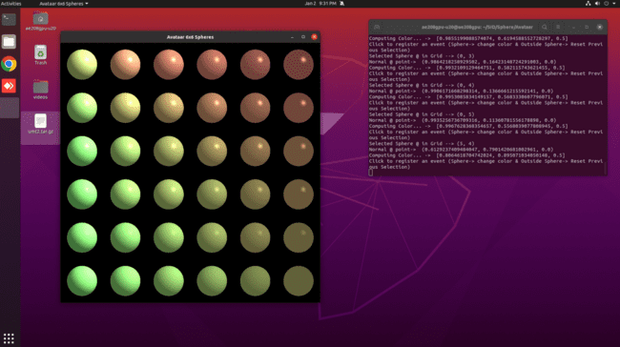
Review 02-01-2024
Result (All Spheres Changed)
Sphere Application

Slide 20
--------- THANK YOU ---------

